Slide 1


Engaging Your Community with Open Data + ArcGIS Hub
Patrick Hammons
Notes:
Strategies
Ways to manage community strategy with esri tools

Slide 2
Community Engagement
Our definition

Slide 3


Two-way community engagement
Two-way conversations and information exchanges
Asking two questions:
1. What do citizens want from their government?
2. How can the government better
assist their citizens?

Slide 4


Citizen Role
Government Role

Slide 5

Notes:
The citizens hold so much local knowledge - no one cares so much about a city block as the people who *live there*.
- This is their home; where they raise their kids; it’s their neighbors and friends.
They have a vested interest in understanding their neighborhood
ensuring accurate representation and having an active, empowered voice for their needs.
Each of these people have a different skill
Skills that are used develop better and more innovative solutions
Some citizens are more engaged than others and want to contirbute and give feedback on new policies and help move things through the development process.

Slide 6

Notes:
Knowledge
Access
Expertise, support
Visibility
Keepers of the data, knowledgeable about the data.
They have access to some tools that citizens can leverage to obtain information and report information.
They are domain experts and can provide support.
Can create initaitives and spaces, opportunity for engagement to thrive in new ways and to take it seriously.

Slide 7


Roles
Citizen Role | Government Role
Local knowledge | The data!
Vast resources | Tools
New insights | Support
Enthusiasm | Opportunity

Slide 8
Methods

Slide 9
How do we position ourselves and allocate our resources to best encourage this two-way community engagement?

Slide 10


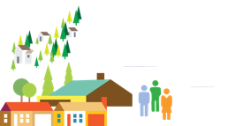















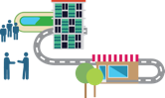

Open Data
Open data is a very good
passive strategy for citizen engagement
An INNOVATION
ECOSYSTEM
Agency Staff
Community Leaders
YOU
LOCATION STRATEGY
OPEN DATA
Citizens
Academia
Start-Ups

Slide 11
Reveal data in visual, understandable, and interactive ways.
Make civic data open, explainable, and easy for diverse populations to understand.

Slide 12
More than just data altogether
Consider the questions…
What stories do the data tell?
How can we generate insights?
How is the data being used?
What questions can we answer more simply?
Consider the solutions…
Story Maps
Operations dashboards
Locator applications
Pages
Turning data into information

Slide 13
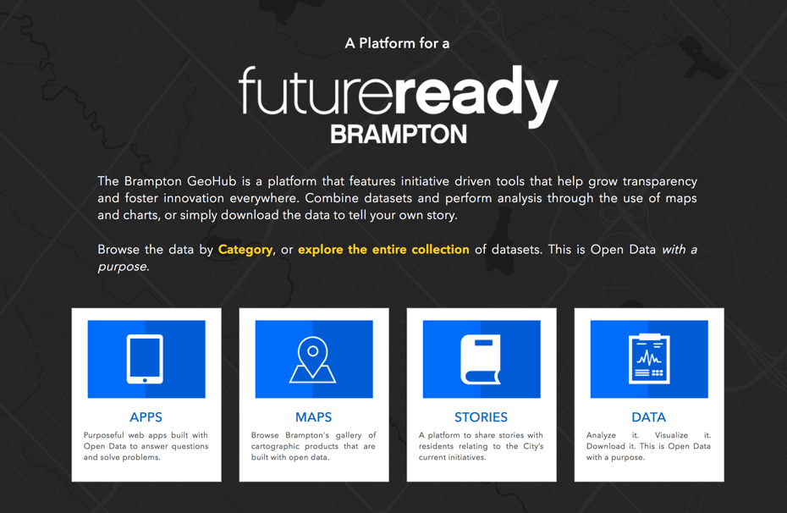

Slide 14
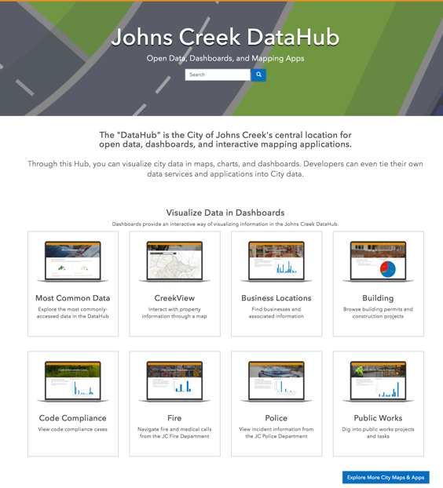

Slide 15
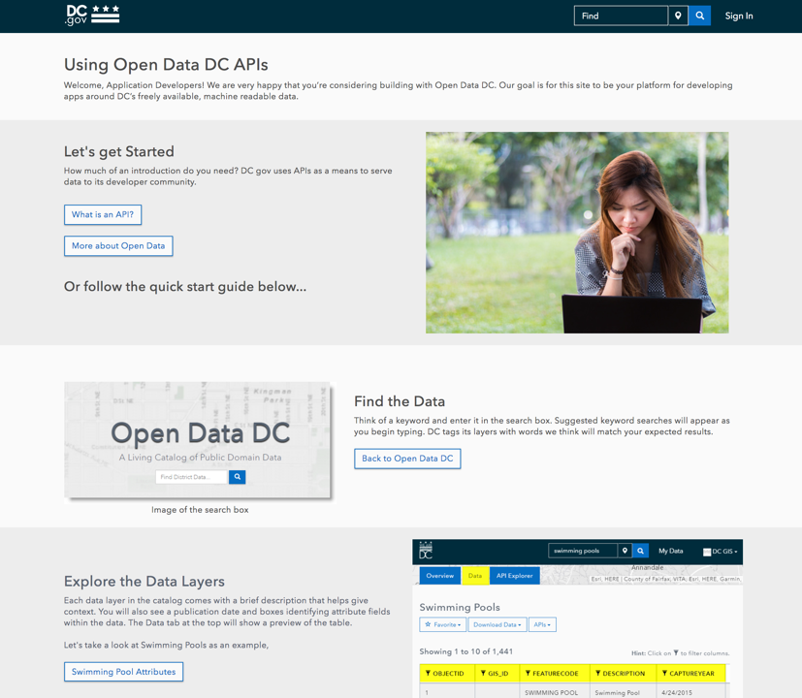
Introduce your developer resources and APIs

Slide 16
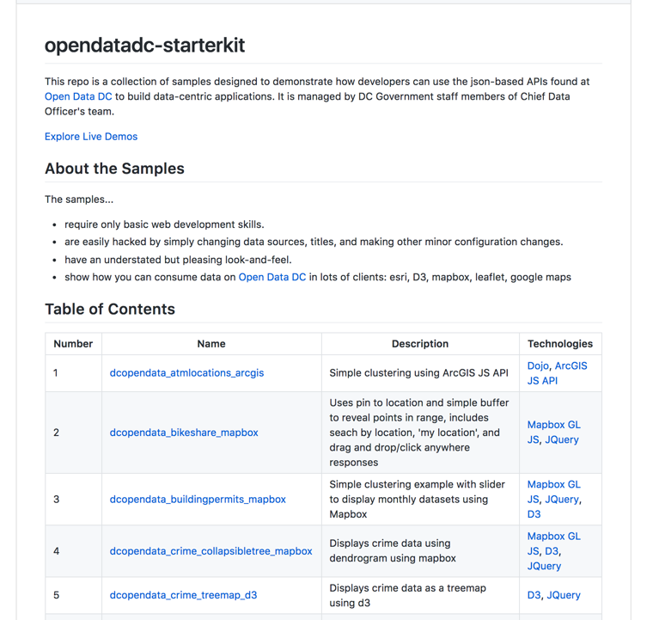
Provide starter materials

Slide 17
How do you also achieve an active strategy of community engagement?

Slide 18
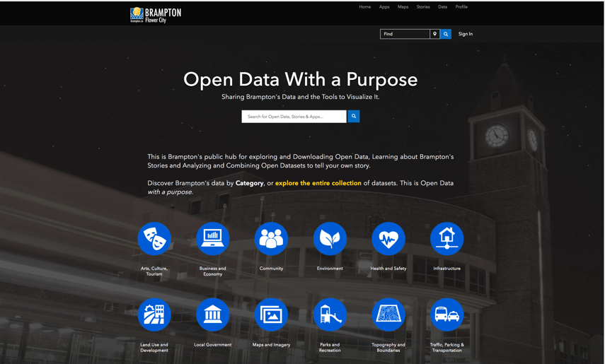
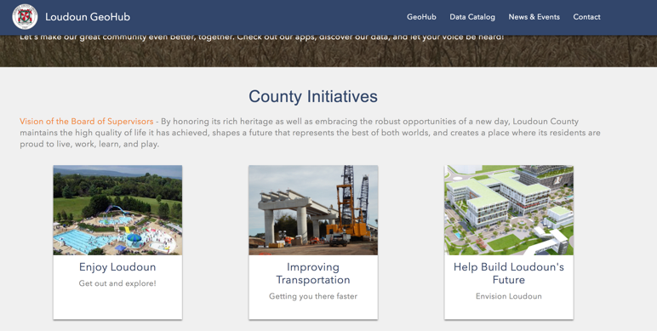
Transform your open data into micro sites towards policy initiatives that are engaging to your community

Slide 19
Your community is an incredible data source.
Notes:
surveys

Slide 20
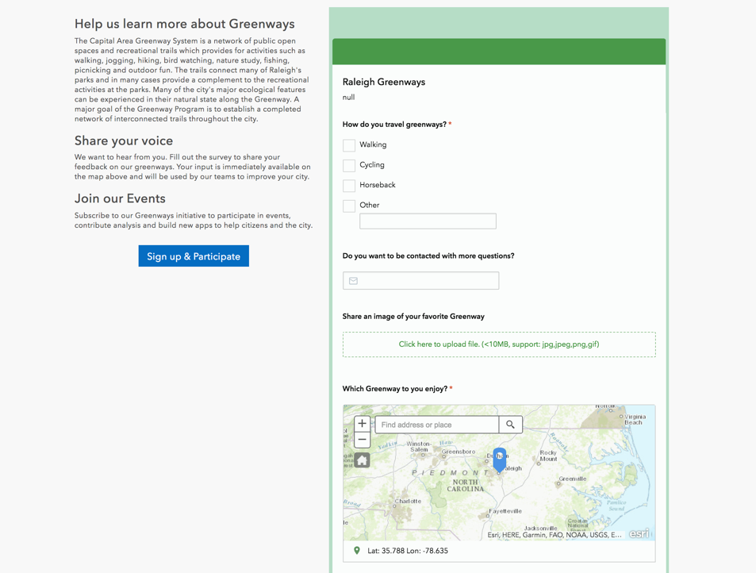

Slide 21
Two types of survey
Collect data
Enable your community to help fill in missing data about your area
Collect opinions
Leverage your community to prioritize action and share plan options

Slide 22

Tap into your schools for project based work
Getting government data directly into the hands of citizens
ConnectED
Pushing into commercial apps

Slide 23
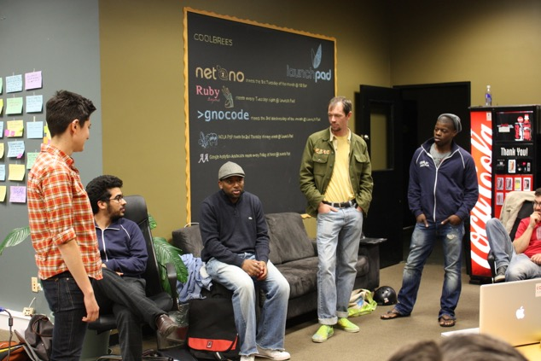
Hold events to discuss those initiatives and gather interested community members
Creating physical spaces where people can:
Discuss concerns
Discover solutions
Notes:
Create democratic spaces for people to gather. Here governments might uncover things that they haven’t considered before.

Slide 24

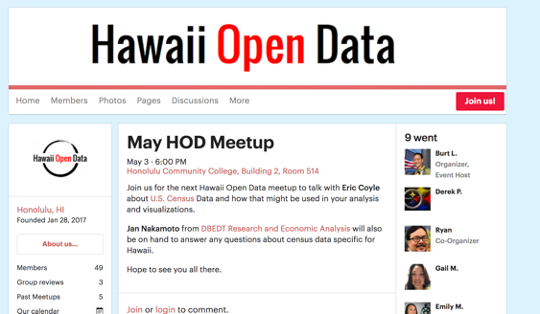
Create a social presence
A social media page for open data (passive engagement) to connect resources and provide a feedback channel
A social media page for each initiative

Slide 25
ArcGIS Hub: Community
Esri is working to make it easier to manage active and passive community engagement
Manage community outreach and engagement
Named ArcGIS users for community participants
Digital public spaces for two-way collaboration

Slide 26

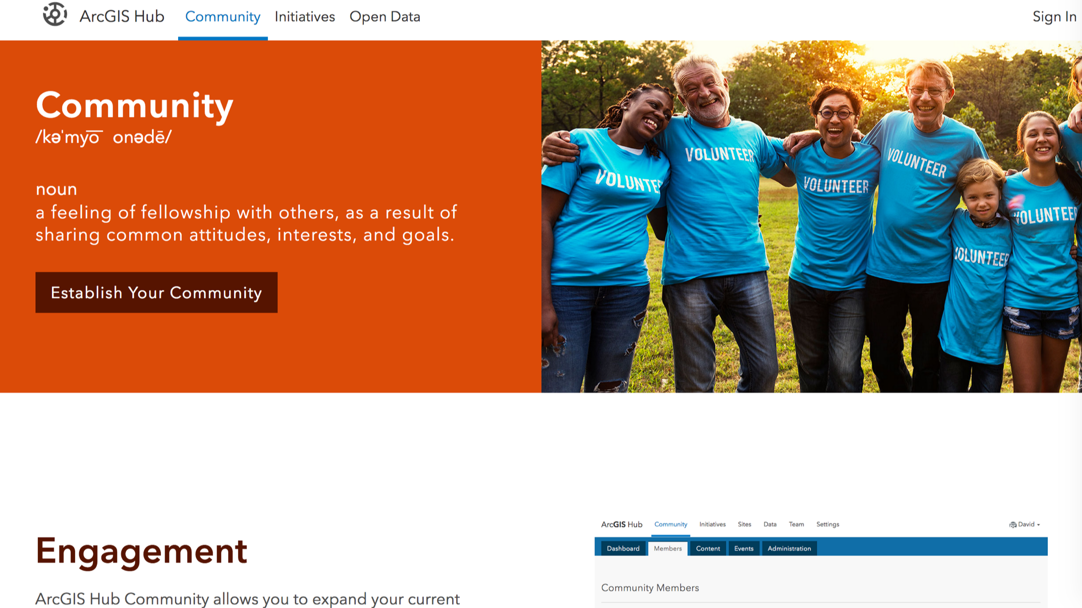
Introduction to the Hub

